Slide 1
Architecture of DBMS
The Internal Level: The internal level have a internal schema. which describes the physical storage structure of the database. The Database not only store the data it also Store the information about the data i.e. Known as meta data . This Data Is stored in Data dictionary.
The conceptual level : The conceptual level has a conceptual schema, which describes the structure of the whole database for a community of users . It basically hides the physical Storage details .At this Level database Designer describes the entities , datatypes and the relationship, user operations , and constraints in the conceptual schema.

Slide 2
The External Schema: It includes a number of external schemas or user views. Each external schema describes the part of the database that a particular user group is interested in and hides the rest of the database from that user group . In this different views can be provided to the users viewing the same database.

Slide 3
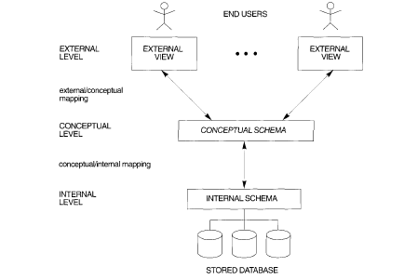

Slide 4
Data Independence
It is Ability to change the one level of database without effecting the next higher level.
There are two types of Data independence Exist in the Database Systems:
Logical Data Independence : Is is basically ability to change the conceptual schema without altering the external schema. For example: if we add a data item into some table that will be reflected in the Conceptual Schema of the database without changing the external view.

Slide 5
Physical Data Independence :It is ability to change in the internal schema without affecting the conceptual schema . changes in internal schema may be required for improving the performance of retrieval or updation functions.

